Slide 1

U.S. Incarceration Rate Comparison
This study compares the rate of Black incarceration to the rate of total incarceration in the U.S.

Slide 2
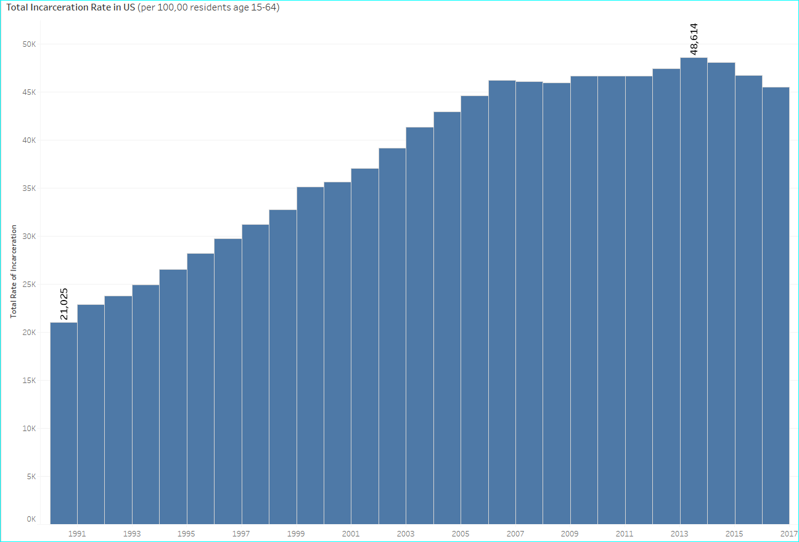
The Rate of Incarceration in the U.S. has risen steadily since 1990, peaked in 2014, then slowly started to fall
Rate of Total Population Incarcerated in the U.S. from 1990-2016
All numbers are rates per 100,000 residents, ages 15-64

Slide 3
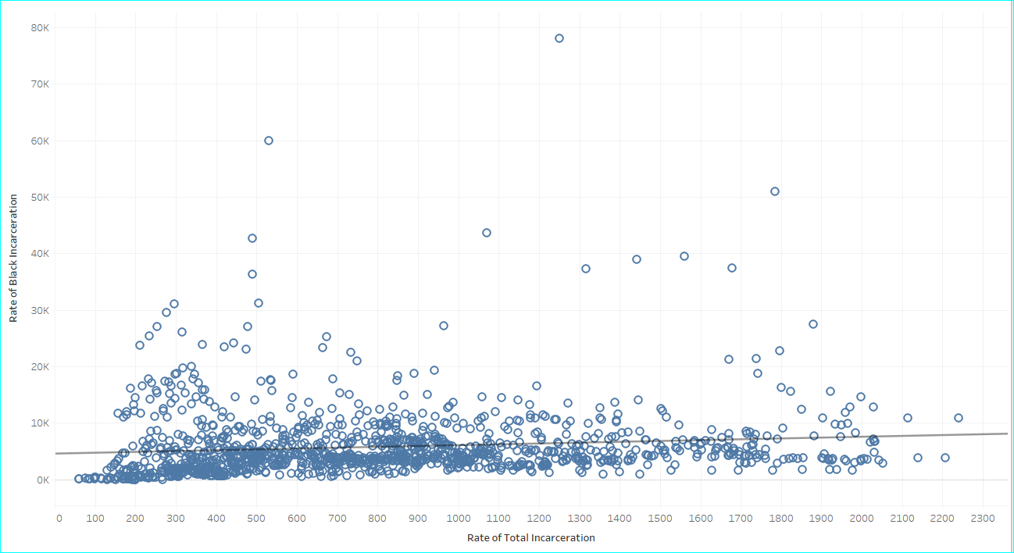
Correlation Between the Rate of Black Incarceration and Total Incarceration
Using linear regression, the line is almost horizontal, showing that there is very little correlation between the rate of black incarceration and total incarceration. In addition there is high variance as illustrated by the many data points that fall far from the regression line.

Slide 4
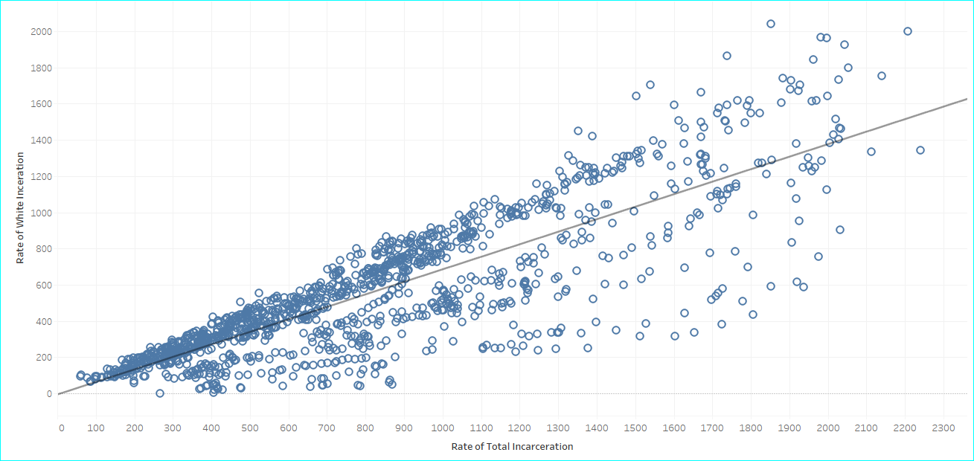
Correlation Between the Rate of White Incarceration and Total Incarceration
On the other hand, when comparing the rate of white incarceration to total incarceration, there is close correlation with much less variance.
Hypothesis: In the U.S. the rate of incarceration in the total population will not predict rate of incarceration in the Black population.

Slide 5
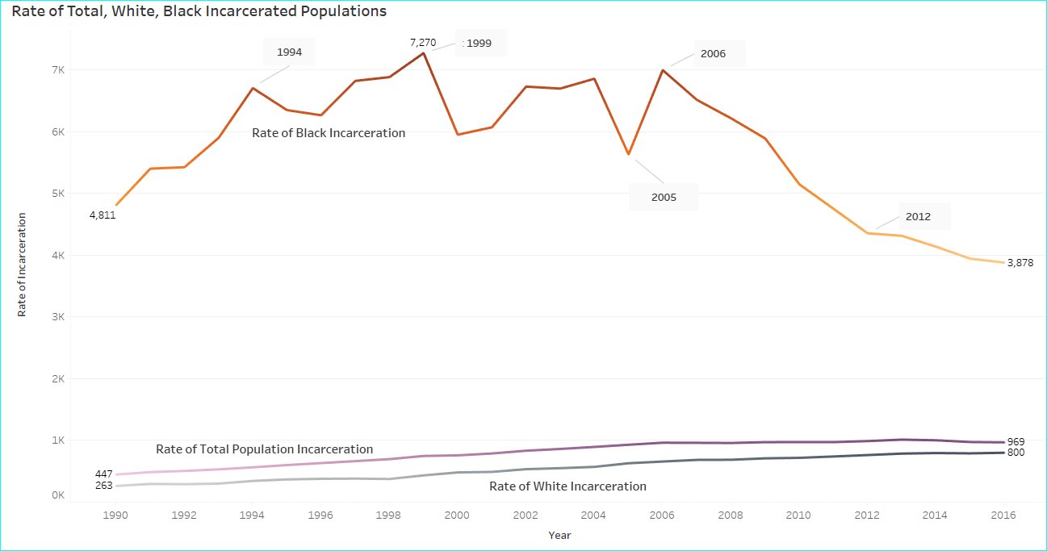
Hypothesis is True
The rate of Black incarceration is much higher than the total population rate. It is worth exploring the sharp downward trend in Black incarceration rate while the total population rate is slowly rising.

Slide 6
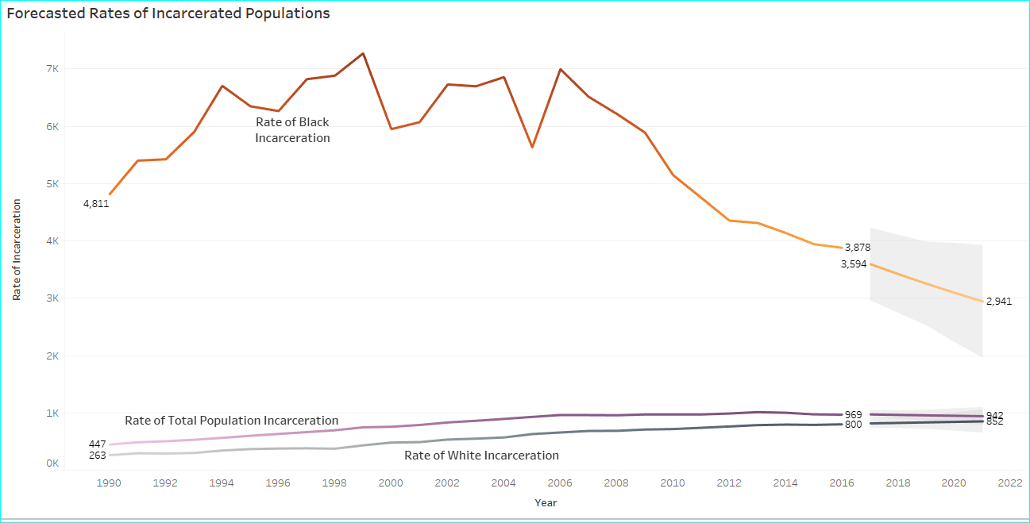
5 Year Forecast
A five year forecast shows the rate of Black incarceration continuing the downward trend while total incarceration levels off. Since this 5 year forecast reaches 2021, it is worth comparing these estimated numbers to today’s actual numbers.
using an additive model with no seasonality

Slide 7
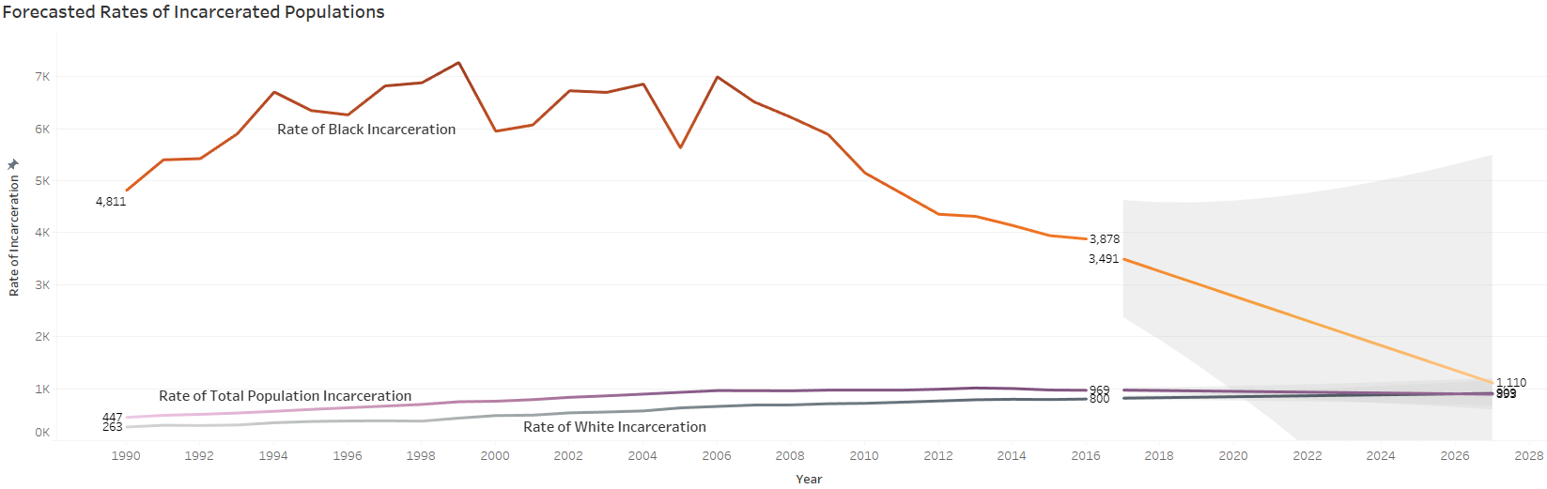
2027 Forecast
Using the same model, the forecast shows the rate of Black incarceration meeting the rate of total incarceration in 2027.

Slide 8
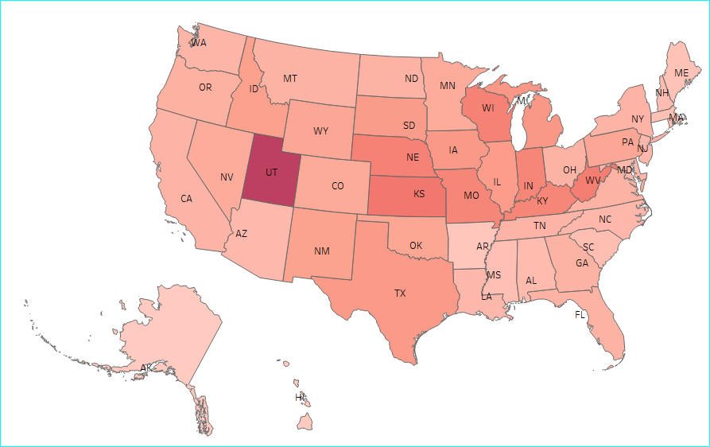

Next Steps
Since most incarceration is not on the federal level, but on the state and county¹, one way to explore these trends is to look into the change in state, county and city laws from 1990-2016. As shown below, there is a large variation in Black incarceration by state.
Black Incarceration Rate Per 100,00 Residents

Slide 9
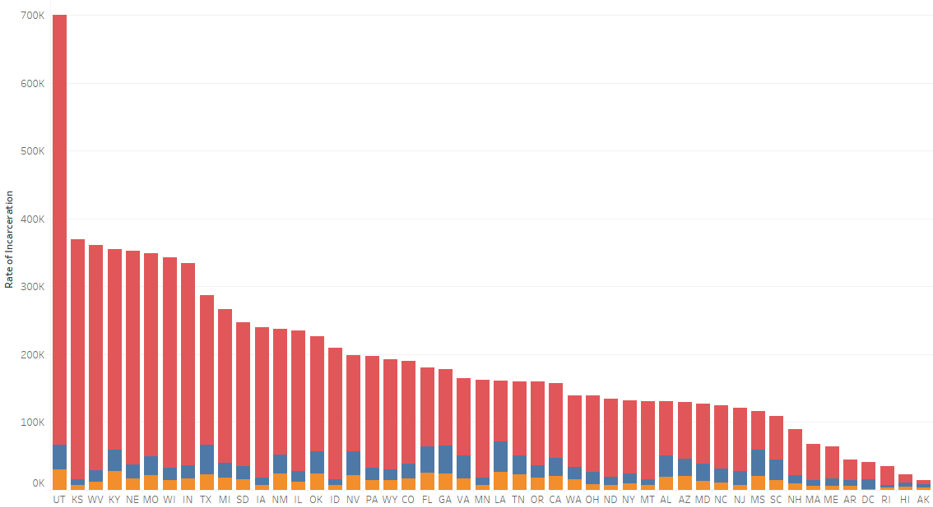

Next Steps (continued)
Below is a comparison of Black, White and Total Incarceration rate by state. It invites exploration into why the rates of black incarceration are so different by state in comparison to total and white rates.

Slide 10
Limitations of this Study
Data was sourced from the Vera Institute of Justice. Since youth under age 15 and adults over 64 are at very low risk of jail incarceration, Vera removed these age groups from the dataset.
Since there were many null values in the years 1970-1989 and 2017-2018, this study used only data from 1990-2016.
Endnote
¹ Criminal Justice Reform at the State Level, Brennan Center for Justice, retrieved 8/6/2021
For More Information
Visit this study’s Github
For an interactive view of the data, please visit Tableau Visualizations

